Slide 1
15th ALARA Network Workshop and 5th EUTERP Workshop
Education and Training in Radiation Protection – Improving ALARA Culture
Rovinj/Croatia, May 2014
PROVIDING QUALIFICATIONS AS THE KEY TO PROFESSIONAL RADIATION PROTECTION CULTURE
RP Education and Training in Germany in the light of the new EURATOM BSS
Julian Vogel, Ralf Stegemann
Division RS II 3 – Supervision in Radiation Protection
julian.vogel@bmub.bund.de, rsii3@bmub.bund.de

Slide 2


RP culture, E&T, and the BSS
Protection culture strongly dependant on personal qualifications
E&T of staff and experts predominantly important so ensure availability of expertise and awareness
E&T Closely linked to conferral of responsibility and accountability
Existing national systems challenged by new functions in 2013 BSS?

Slide 3
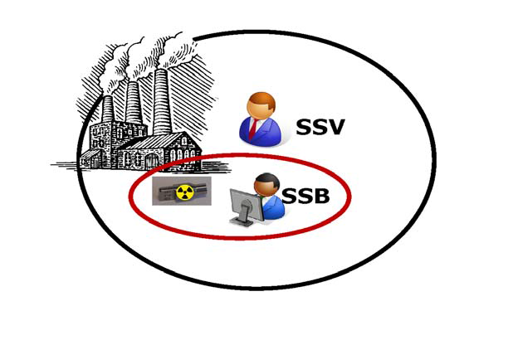
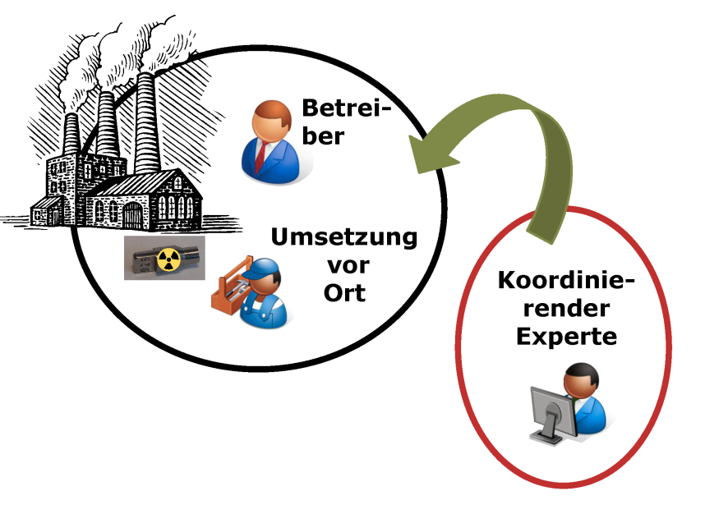
RP Functions in Germany
Strahlenschutzverantwortlicher (SSV), “RP Executive“
  Owner/director/board member of undertaking
  Accountable for all legal duties of undertaking
Strahlenschutzbeauftragter (SSB), “RP Supervisor“
  Designated by SSV, number as required
  Responsible for implementation of RP
  Personal legal duties (for area of designation)
Preconditions for designation of SSB
  1. Personal Professional Integrity
  2. Competences within undertaking to perform duties
  3. “Requisite Expertise in RP”
NB. translations to EN may vary (non-standardized)

Slide 4
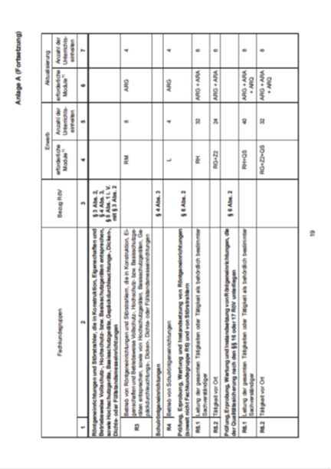
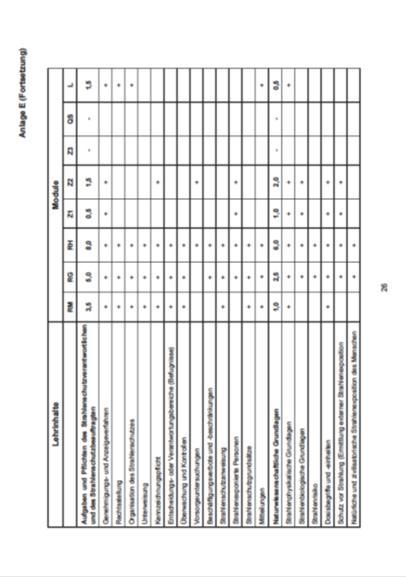
“Requisite Expertise in RP”
Requirements
  1. Appropriate professional education
  2. Successful completion of courses in RP
  3. Sufficient professional experience in relevant practice
Examined and conferred by competent body
Concrete requirements in regulatory guidelines (~ 60 groups of expertise depending on type of practice)

Slide 5
DE system of Responsibilities
Advantages of DE system
Responsibilities very clearly assigned
Accountable person available in undertaking
Person with expertise available „in-house“
J.-W. Vahlbruch
Limitations of training (graded approach)
Level of qualification dependant on risk of practice
Recognition only valid within limits of qualification
For low-risk practices only limited training is feasible

Slide 6

RPE and RPO in the new BSS
Personal qualifications strengthened in 2013 BSS: framework for E&T and recognition – focus here on two “new” functions
Radiation Protection Expert
“having the knowledge, training and experience needed to give advice”
“competence recognised by the comp. authority”
“may be assigned tasks”
➲ undertaking required “to seek advice from RPE”
Radiation Protection Officer
“technically competent [...for a…] type of practice”
“supervise or perform the implementation”
“undertakings […provide…] with the means necessary”
➲ new function, optional for implementation by MS

Slide 7
RPE in BSS: Facts and Fiction
Concepts of RPE/RPO are used in other contexts – leads to some confusion what BSS do (not) require or prescribe
RPE works full-time in RP (RPO may work part-time)
RPE not responsible for implementation of tasks
☒
~
RPE must be independent from undertaking
☒
RPE practically identical to „qualified expert“ from 96 BSS
RPO duties may be assigned to RPE
☑
☑
RPE is in EQF level 6/7/8
EQF/ECVET NOT applicable to the scope of EURATOM!
RPE must have university degree
☒

Slide 8
Implementing the RPE
Independent, external consultant
Assignment of legal duties / responsibilities: National competence
Not one, but 28 (systems of) RPE
Various options must be respected by
  model curricula
  recognition schemes
Personal prediction: Diversity will be larger than for 96 BSS
Choice for MS:
§_{MS1}
Competent for specific type of practice
Comprehensively trained for a wide class of practices
--- practices ------- practices ---
- involvement ---- involvement -
§_{MS2}
§_{MS3}
Responsible Unit within company

Slide 9
Correspondence DE / EU
§
RPE
Recognized competence
RPO
Means provided by u.
Under-taking
§
SSV
“Head” of undertaking
SSB
Requisite expertise in RP
Competence within u.
Reworking legislation is work in (first steps of) progress
Change of system only viable if RP is improved
Profound changes not foreseen for most practices

Slide 10
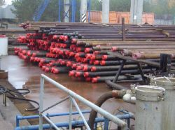
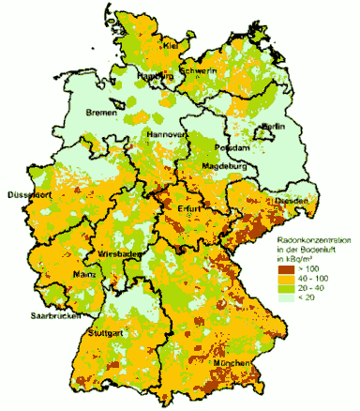
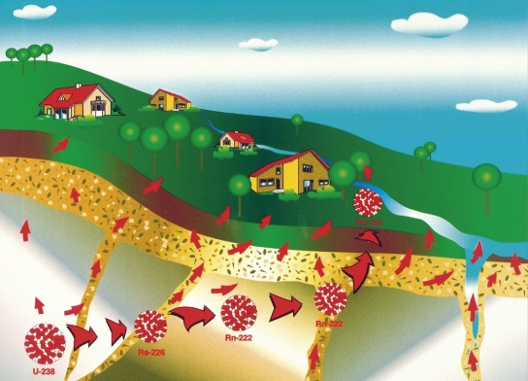
Challenges for E&T
New fields of RP regulation
  NORM activities now regulated as practices
  Radon (at workplaces)
  Spacecrew
Information and Training of workers (less international work done so far?)
BfS (Oil and gad industry)
New technologies (e. g., medical sector!)
New forms of teaching and learning
International exchange welcome and important
Report t o Pariament 2009
BfS

Slide 11

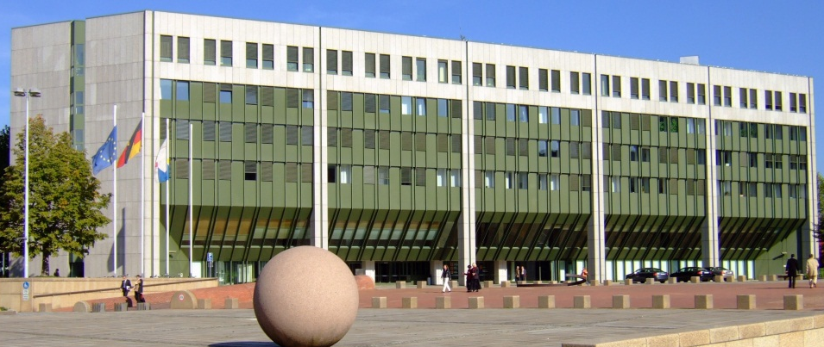
Take Home
BSS offers a multitude of options for implementation
Successful guidance (or reference standards) have to respect this diversity
Ensuring quality of E&T remains a challenge
Nicolas Brignol, CC-BY-SA-2.0-FR
Germany has implemented a system based on
  clear responsibilities
  and a graded approach to training requirements
  in line with the 2013 BSS
Hans Weingartz, CC-BY-SA-2.0-DE

