Slide 1
SERIOUS 3D GAME FOR EDUCATION AND TRAINING IN RADIATION PROTECTION
Rovinj – 2014 Alain PIN (CEA/INSTN/UECO) – France
Notes:
Good morning ! Good evening lady (ies) and gentlemen.
My name’s Alain PIN.
I work at the national institute for nuclear science and technology as a part of the French Atomic Energy and Alternative Energy commission.
At the teaching unit of Cherbourg, I’m a technical officer in charge of courses in radiation protection and in serious game developments.
Before starting, I would like to thank the program committee to invite me to talk about our serious game OSIRIS

Slide 2
Summary of presentation
Presentation of the INSTN
Why a simulation tool ?
The game and his functionalities
Short video demonstration of OSIRIS
Initial feedback and future developments
Notes:
Today I’m going to start off by a short presentation of the INSTN,
Then, I’ll say some words about the reason of the development of simulation tools.
I will present the game and his functionalities.
After that, I will made a short presentation of the game itself with a home made video,
And I will finish by talking about our initial feedback and future developments.

Slide 3
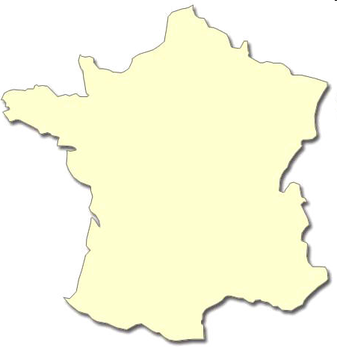
L’INSTN
The National Institute for Nuclear Science and Technology (INSTN) is a higher education institution.
The INSTN’s mission is to disseminate the knowledge and know-how developed at the CEA, especially :
  in nuclear operation and maintenance,
  nuclear safety,
  waste management,
  clean-up and dismantling,
  radiation protection,
  radiation detection and measurement,
  nuclear medicine …
Cherbourg - Octeville
Saclay
(Headquaters)
Each year, we train about :
7200 trainees in continuing education,
900 students,
And 1500 PhD students.
Grenoble
Marcoule
Cadarache
Notes:
As a part of the CEA (French Atomic Energy and Alternative Energies Commission), the National Institute for Nuclear Science and Technology (INSTN) is a higher education institution. The INSTN’s mission is to disseminate the knowledge and know-how developed at the CEA, especially in nuclear operation and maintenance, nuclear safety, waste management, clean-up and dismantling, radiation protection, radiation detection and measurement, nuclear medicine …
Our Headquaters is located in Saclay. And there are 4 others teaching units, three of them are in south of France and the last one in Cherbourg, in Normandy.
Each year, we train about :
7200 trainees in continuing education,
900 students,
And 1500 PhD students.

Slide 4
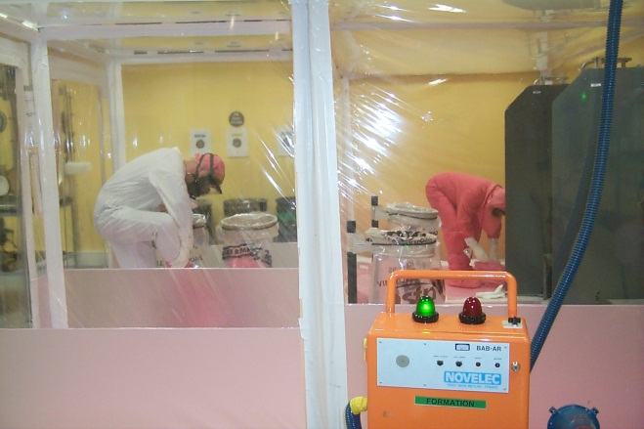
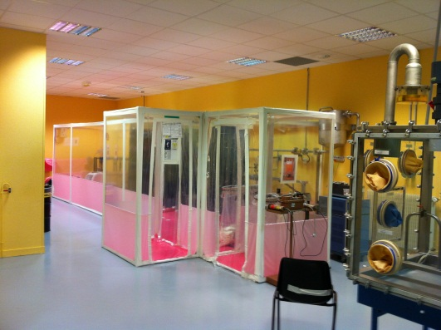
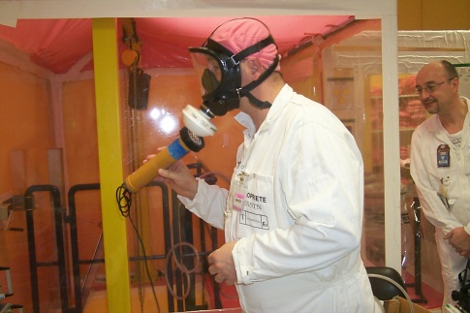
Why a 3D simulation tool ?
The practical implementation of theoretical knowledge is traditionally done through means such as: educational mock-up facilities for hands-on training, teaching laboratories ... , …
In particular, the educational mock-up facilities for hands-on training are intended to immerse learners in an environment, as close as possible, of the real environment. However, the construction costs often limit the realism that can be achieved and the possible hardware upgrades.
Virtual reality appears as a complement of traditional tools, allowing learners to project in realistic environments without any risk (no radioactive sources, for example).
Example of educational mock-up facilities for hands-on training – CEA/INSTN Cherbourg-Octeville
Notes:
Traditionally, we use mock-up facilities for hands-on training to train our trainees (you have some examples at the slide bottom ).
This facilities are very good tools for it.
But, the construction costs often limit the realism that can be achieved and the possible hardware upgrades.
So, virtual reality appears as a complement of traditional tools for several reasons :
First, the virtual reality allows to create more complex and realistic environments for a reasonable price and it allows to simulate the radiation risk.
Secondly, it’s very simple to switch to an another environment.
Finally, we can just remind that the new generation of students is accustomed to using computer tools. They grew up with!

Slide 5
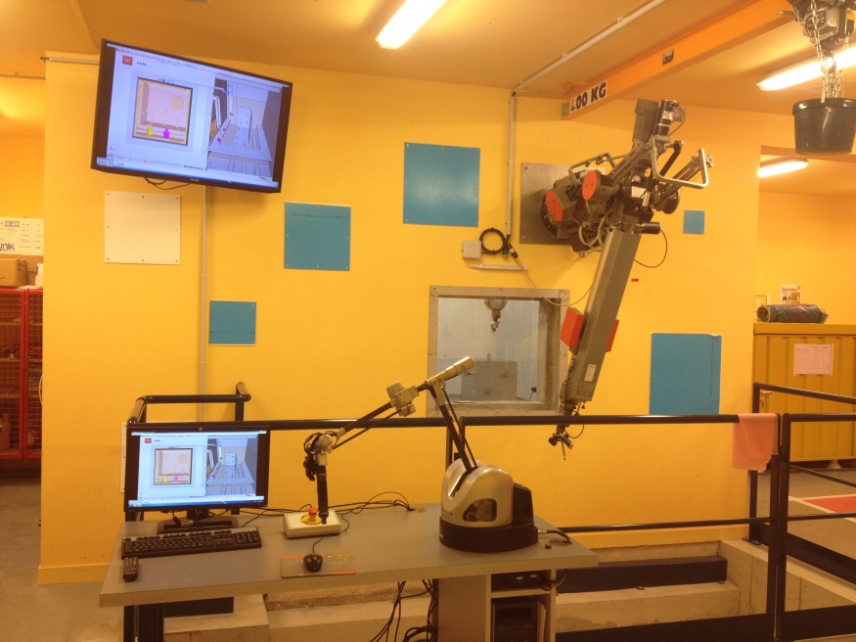
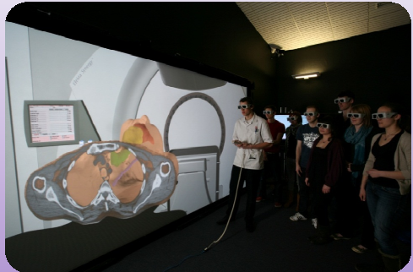
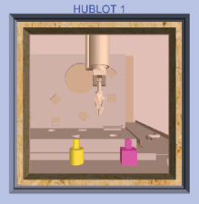
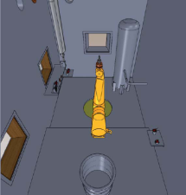
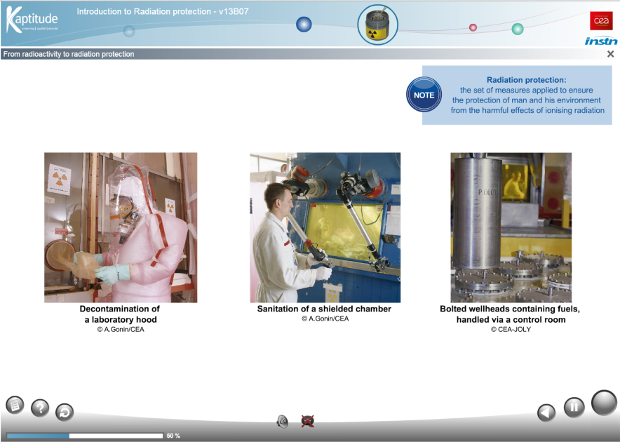
Examples of Simulation Tools investment
Immersive room (Saclay 2014)
Simulation witch HAPTION arm and
a real telescopic telemanipulator
MT200 (2013 - 2014)
E-learning module in radioprotection avalable in English and French (2012 - 2013)
Notes:
So, since 3 years, we have started to develop simulation tools.
On the top left, you can see on the picture a telescopic telemanipulator MT200 and his simulated associated tool, an haption arm!
The haption arm is used to move the slave arm into the virtual environment.
On the top right, an immersive room built in our headquarter last month.
Just below, a ELearning tool on radiation protection developed by INSTN with Kaptitude company.

Slide 6
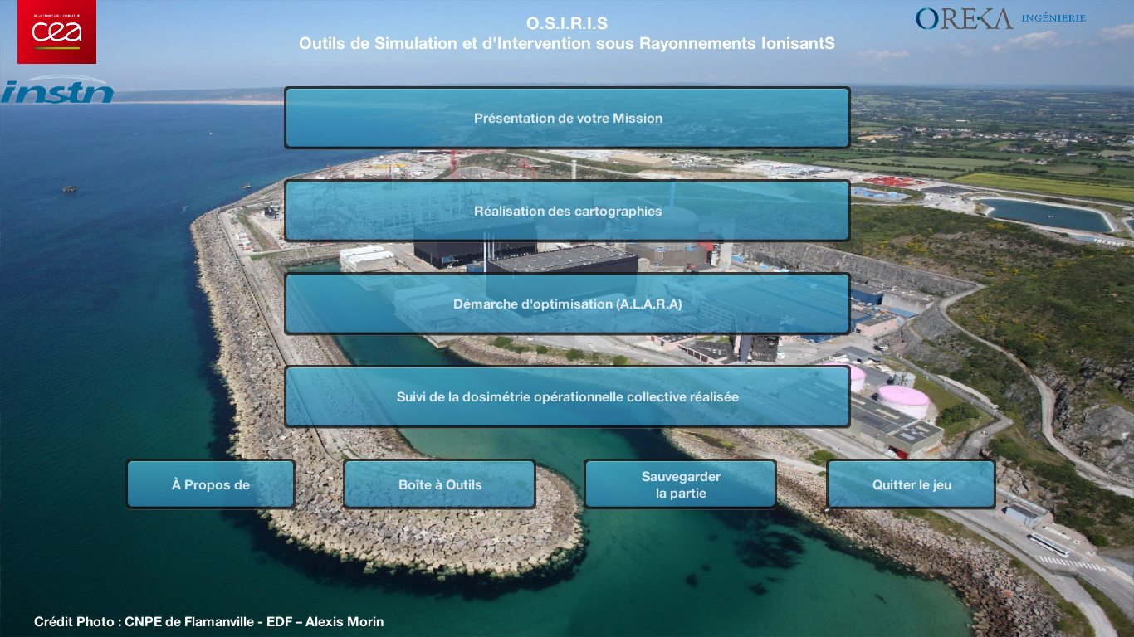
OSIRIS
O.S.I.R.I.S. (French acronym for “Tool for Simulation of work under ionising radiation”) is an innovative teaching tool developed by The National Institute for Nuclear Science and Technology (INSTN /Teaching Unit of Cherbourg-Octeville) and OREKA (Company specialized in engineering 3D software).
Picture 1 : OSIRIS Home page

Slide 7
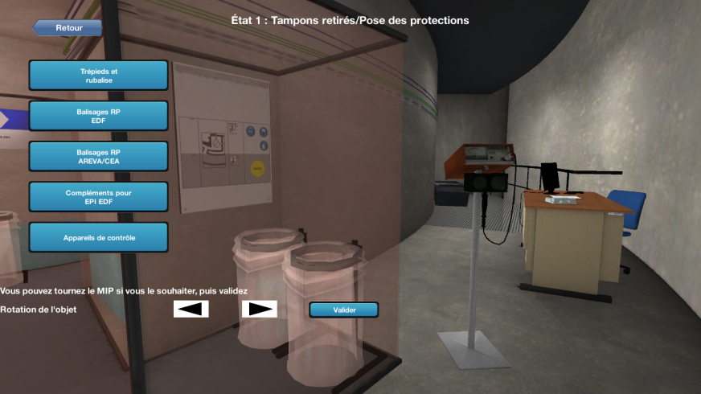
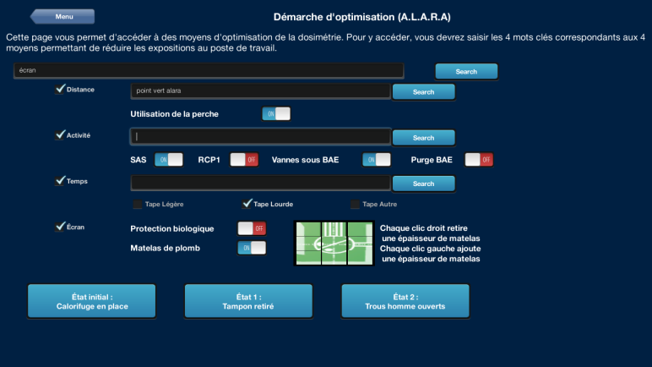
Functionalities of the game
Through the use of this serious game, trainees must:
Carry out dose rate measures and loose radioactive contamination control to establish a predictive dose evaluation,
Think about radiation warning signs to put in place at the workstation and on the necessary collective or portable control instruments.
Implement the principles of radiation protection, in particular the ALARA principle.
Analyse the discrepancy between the predictive collective dose and the collective dose achieved.
Know how to react in case of emergency or in an irregular situation (for example an alarm on an electronic dosimeter).
Picture 3 : OSIRIS ALARA menu
Picture 4 : OSIRIS markup and instruments menu
Notes:
Well, now we will look at functionalities of the game.
Typically, the game’s users are technical officer in radiation protection or others persons in charge of radiation protection.
Each items, you can see match with a mission of the technical officer in France.
For each operation in a controlled area, the employers must establish a predictive dose evaluation.
So, the first mission is to carry out ….
Then, we must think about ….
Next, we think about how to reduce doses.
In the real life, during the operation, the technical officer must supervise all doses received (individual and collective doses). Into, the game, we can only control the collective dose.
Finally, we speak about how we must do in case of emergency.

Slide 8
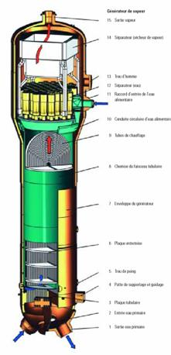
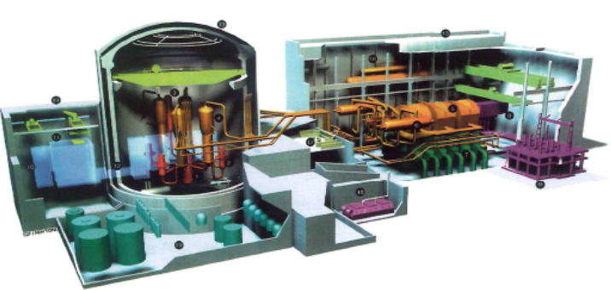
Location of the case study
The case study takes place in the steam generator building, at the level of the bottom of a steam generator, during a checking operation of tubes by using Eddy currents.
Notes:
Just before seeing the video, I would like to localize the action of the game.
On the slide, you have a picture of a nuclear power plant. You can especially see the steams generators.
The case study takes place in the steam generator building, at the bottom of a steam generator, during a checking operation of tubes by using Eddy currents.

Slide 9
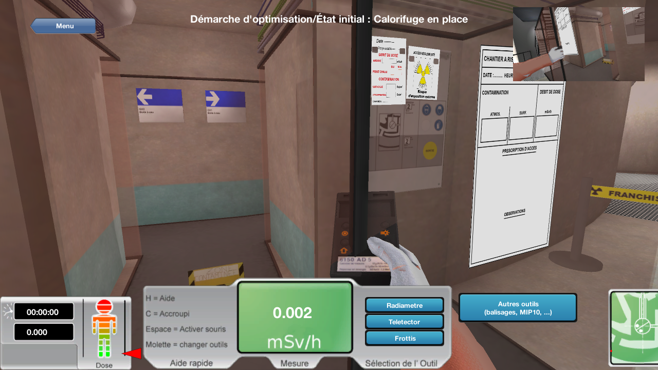
OSIRIS navigation interface
The tool is built on a virtual 3D environment in which users operate in a totally free way in the first-person (the user is immersed in the scene as if the press camera was positioned at eye level).
Picture 2 :
OSIRIS Navigation interface
Duration of stay and effective dose received
Command options, dose rate measured and survey instruments available
Map locator
Notes:
Well, this is the osiris navigation interface.
As you can see, the press camera is positioned at the eye level of the user.
In the hand of the user, you can see a dose rate meter.
The ambient equivalent dose rate is written in the center.
On the right, a map locator On the left the duration of stay and the effective dose received by the user.
To move, the user must use the arrows of the keyboard. The mouse is used to guide the eye of the user.
Well, now we are going in the virtual environment.

Slide 10
Our initial feedback : trainees
Notes:
Well, before conclusion I would like to speak about our initial feedback.
Anonymously, we interviewed the last 100 OSIRIS users 1 month ago.
38 of them responded until now.
You have the results on the slide.
As you can see, a large part of them approve this new method of learning.
In complement, I can say that the youngest users support more than the others, certainly because they grew up with new technologies.
Some of them didn't agree with OSIRIS because they didn’t recognize themselves in the case study.
But this, can be easily corrected by changing the 3D environment.

Slide 11

Conclusion
For 3 years, OSIRIS has been used by about 200 trainees in practical courses in radiation protection (Essentially the prototype, then the commercial version since October 2013 ).
In our process of updating our training methods,
the 3D serious games represent an alternative
of our traditional methods.
Future add-on
Develop others environments : medical, research, recycling used fuel factory, …
Add the possibility to “drag and drop” radioactive sources into the virtual environ (several type of sources : point sources, cylindrical sources, …).
The ability to track the learning of trainees while using the game.
Notes:
To conclude,
OSIRIS has been used by about 200 trainees in practical courses in radiation protection (Essentially the prototype, then the commercial version since October 2013 ).
We think that it represents a good alternative of our traditional methods.
As we have seen, it is important that users can recognize themselves in the 3D environment, so we think develop others environments.
We are also working on the possibility to add radioactive sources into the virtual environment by drag and drop and add the ability to track the learning of trainees while using the game. This is necessary to evaluate the knowledge of trainees.

Slide 12
Thank you for your attention
OSIRIS WEBSITE : http://osiris.oreka-group.fr/

