Slide 1
EAN
The European ALARA Network
Welcome address to
European ALARA Network and EUTERP Workshop on Education and Training in Radiation Protection: Improving ALARA culture
Dr. F.Vermeersch
Chairman EAN
15th European ALARA Network Workshop and 5th EUTERP Workshop Education and Training in Radiation Protection: Improving ALARA Culture
Rovinj, Croatia, 7th-9th May 2014
Rovinj May 7, 2014

Slide 2
ALARA Network
History and Evolution
1996
  cooperation of experts from various European organisations mediated by the European ALARA training course
    European Support from 1996 to 2004
    EC support to three workshops
    Enthusiast individuals, supported by their institutions
Evolution to a self supporting network
2005
  EAN a legal entity, non-profit organisation under French law
    Coordination CEPN, PHE and a group of European experts
    EAN Administrative board (financial)
      Chairman, vice-chairman, treasurer, secretary
    EAN steering group (focus and activities)

Slide 3
EAN objectives
First
  ALARA in industry and research
    Industry → non NPP (ISOE for NPP)
Later
  ALARA in the medical field
  ALARA in NORM-industry
Future
  All exposure situations, planned, existing and emergency situations

Slide 4
ALARA Network objectives
Promote a wider and more uniform implementation of the ALARA principle for the management of worker, public and patient exposures in all exposure situations,
Provide a focus and a mechanism for the exchange and dissemination of information from practical ALARA experiences
Identify and investigate topical issues of common interest to further improve the implementation of ALARA

Slide 5
EAN participation
Voluntary cooperation
Broad range of experts
  radiation protection and safety authorities
  industrial companies and services
  research institutions
  Medical
  ….
Evolution from 8 to 20 countries since 1996
Financial support through contributions from different institutions, companies, regulatory authorities, …organised per country (a representative or contact person per country)

Slide 6
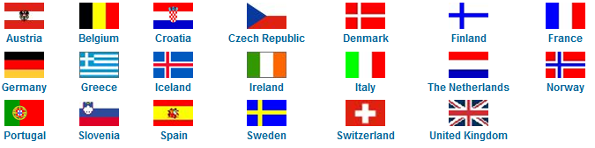

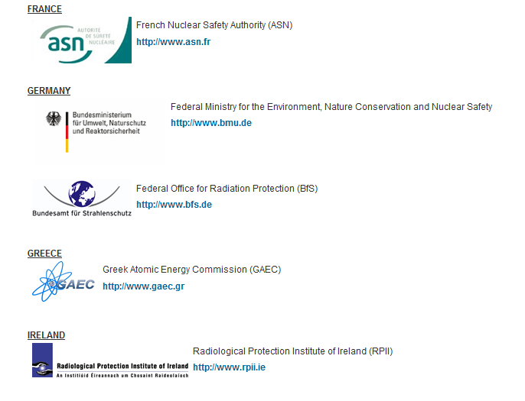
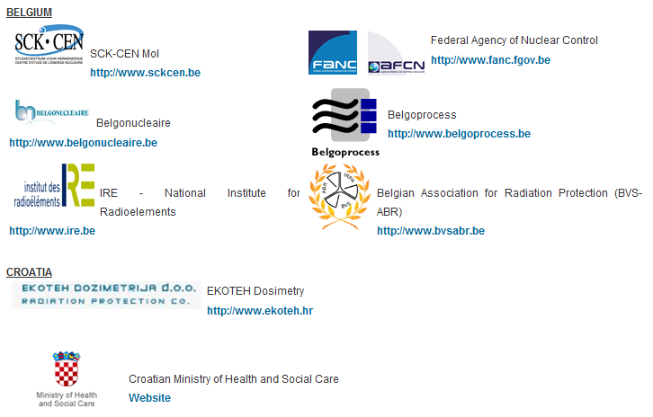
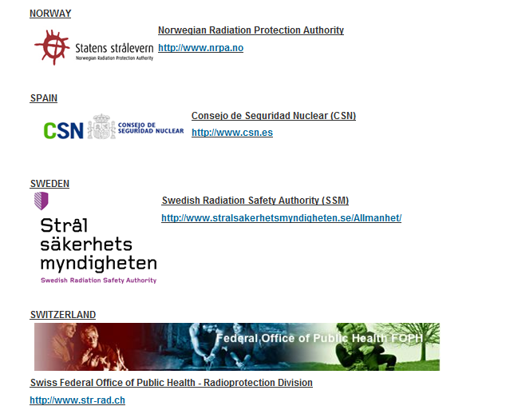
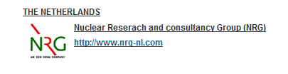
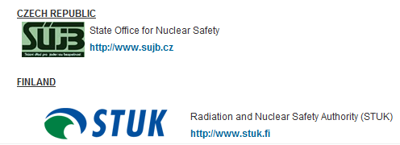
Members of the Steering group
umicore

Slide 7
Activities and Achievementes
How does the network work

Slide 8
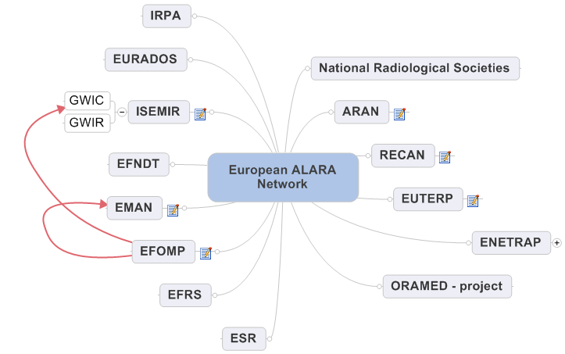
Contacts with other organisations
Networking
Special Liaison Organisation to ICRP

Slide 9
Collaboration with European and international organisations
Medical field
  EFOMP – European Federation of Organisations for Medical Physics
  EFRS – the European Federation of Radiographer Societies
Industry
  EFNDT – European Federation for Non-Destructive Testing
Invited to participate in the EAN meetings (steering group, workshops, WG)

Slide 10
Surveys
Different surveys:
  The implementation of the European Basic Safety Standards in Directives 96/29 and 97/43 in national regulations (2006),
  The management of radioactively contaminated soils (2006),
  Potential exposures in nuclear installations (2007),
  The Diagnostic Reference Levels (DRLs) in Europe (2007),
  Radon exposure management (2010)
  Aircrew exposures (2011)
  Declaration systems of incidents (2011)
  Dose guidance for emergency workers (2011)

Slide 11
EAN Activities and outputs
Information
Networking
Workshops
Input
Recommendations
Guidance
Return of experience
output
EAN Workshops
Support to European Surveys
EAN working groups
ALARA Newsletter
EAN Website

Slide 12
EAN workshops
Papers
Posters
Working groups
Recommendations – documentation, Guidance
Workshops on different topics
  60-120 experts
  Expert papers
    Scene setting
    Practical cases
  Poster session
  Working groups (questions, discussion topics)
  Output of the workshop
    Recommendations
    Documented in
      Newsletter
      EAN Website
      National radiation protection journals

Slide 13
Workshops
1 | ALARA and decommissioning | Saclay, France, 1997
2 | Good radiation practices in industry and research | Oxford, United Kingdom, 1998
3 | Managing internal exposure | Munich, Germany, 1999
4 | Management of occupational radiological and non-radiological risks: lessons to be learned | Antwerp, Belgium, 2000
5 | Industrial radiography, improvements in radiation protection | Rome, Italy, 2001
6 | Occupational exposure optimisation in the medical and radio-pharmaceutical sectors | Madrid, Spain, 2002
7 | Decommissioning and site remediation | Arnhem, Netherlands, 2003
8 | Occupational radiological protection control through inspection and self-assessment | Uppsala, Sweden, 2004
9 | Occupational exposure to natural radiation | Augsburg, Germany, 2005
10 | Experience and new developments in implementing ALARA in occupational, public and patient exposures | Prague, Czech Republic, 2006
11 | ALARA in radioactive waste management | Athens, Greece, 2008
12 | ALARA issues arising for safety and security of radiation sources and security screening devices | Vienna, Austria, 2009
13 | ALARA and the medical sector | Oscarborg Fortress, Norway, 2011
14 | ALARA in existing exposure situations | Dublin, ireland, 2012
15 | Education and Training in Radiation Protection: Improving ALARA Culture | Rovinj, Croatia, 2014
In preparation
16th EAN workshop Switserland, March 2016
on industrial radiography and non-destructive testing

Slide 14
Selection of the workshop topic
Joined workshop EUTERP - EAN
  Education and Training in Radiation Protection: Improving ALARA Culture
The workshop will provide a scene setting and will elaborate on how to further improve education and training in RP and simulate ALARA culture

Slide 15
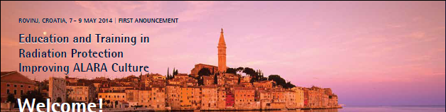
15th European ALARA Workshop

Slide 16
Topics to discuss in the working groups
Tools to improve the effectiveness of training: new methods of delivery, blended learning and post-training interaction
How to measure the effectiveness of training: post-training assessment, ALARA evaluation, etc.
The role of qualification and recognition schemes (ECVET, EQF, etc.) and their value in the workplace
Incorporating ALARA culture in training requirements for radiation workers and managers as well as regulators and inspectors
How to improve risk awareness and the radiation protection and ALARA understanding for different stakeholders and for different exposure situations

Slide 17
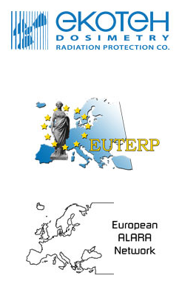
Thanks to
The program committee
Annemarie Schmitt-Hannig (BFS)
Pascal Croüail, Caroline Schieber, Sylvain Andresz (CEPN)
Richard Paynter (PHE)
Sotirios Economides (GAEC)
Mladen Novaković (EKOTEH)
Peter Shaw (PHE)
Nuccetelli (ISS)
Alfred Heffner (SEIBERSDORF-LABORATORIES)
Michèle Coeck, Fernand Vermeersch (SCK•CEN)

Slide 18
Thank you and have a
Successful Workshop

